Slide 1
Bayesian belief networks

Slide 2
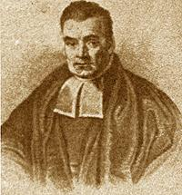

Bayesian Network Motivation
We want a representation and reasoning system that is based on conditional independence
Compact yet expressive representation
Efficient reasoning procedures
Bayesian Networks are such a representation
Named after Thomas Bayes (ca. 1702 –1761)
Term coined in 1985 by Judea Pearl (1936 – )
Their invention changed the focus on AI from logic to probability!
Thomas Bayes
Judea Pearl

Slide 3
Bayesian Networks
A Bayesian network specifies a joint distribution in a structured form
Represent dependence/independence via a directed graph
Nodes = random variables
Edges = direct dependence
Structure of the graph ⬄ Conditional independence relations
Requires that graph is acyclic (no directed cycles)
Two components to a Bayesian network
The graph structure (conditional independence assumptions)
The numerical probabilities (for each variable given its parents)

Slide 4
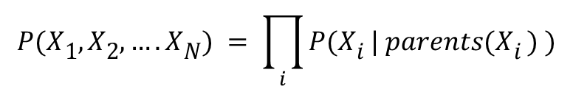
Bayesian Networks
General form:
$$P(X1, X2,….XN) = \prod_{i}{P(Xi | parents(Xi ) )}$$
The full joint distribution
The graph-structured approximation

Slide 5
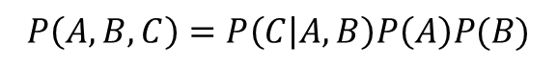
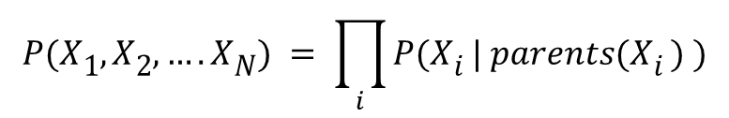
Example of a simple Bayesian network
$$P(X1, X2,….XN) = \prod_{i}{P(Xi | parents(Xi ) )}$$
A
B
$$P\left(A,B,C\right)=P\left(C | A,B\right)P\left(A\right)P(B)$$
C
Probability model has simple factored form
Directed edges => direct dependence
Absence of an edge => conditional independence
Also known as belief networks, graphical models, causal networks
Other formulations, e.g., undirected graphical models

Slide 6
Causality - 1 Icy Roads
Icy Roads
Holmes Crashes
Watson Crashes

Slide 7
- 2 Wet Grass
Rain
Sprinkler
Watson’s
Grass Wet
Holmes’
Grass Wet

Slide 8
Examples of 3-way Bayesian Networks
A
B
C
Absolute Independence:
p(A,B,C) = p(A) p(B) p(C)

Slide 9
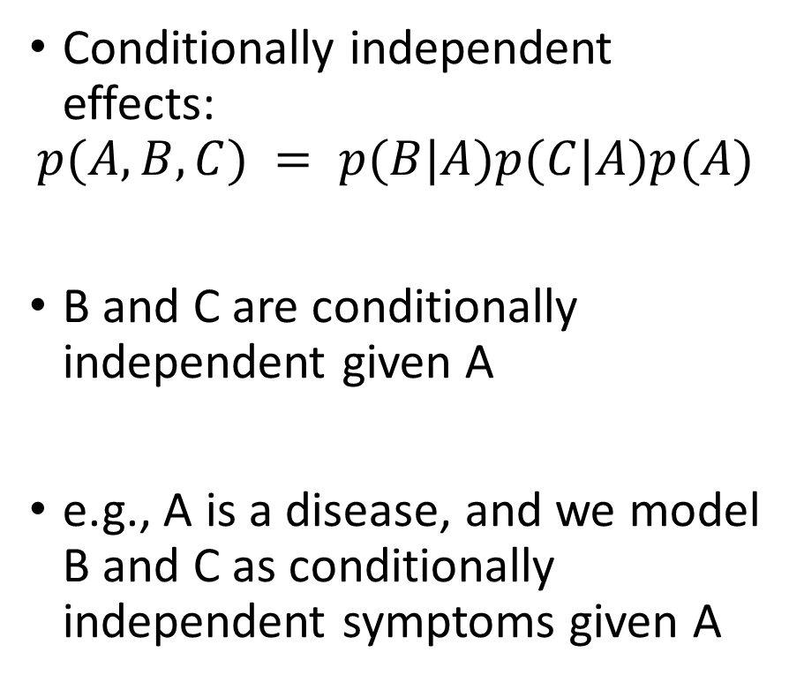
Examples of 3-way Bayesian Networks
Conditionally independent effects:
$$p(A,B,C) = p(B|A)p(C|A)p(A)$$
B and C are conditionally independent given A
e.g., A is a disease, and we model B and C as conditionally independent symptoms given A
A
B
C

Slide 10
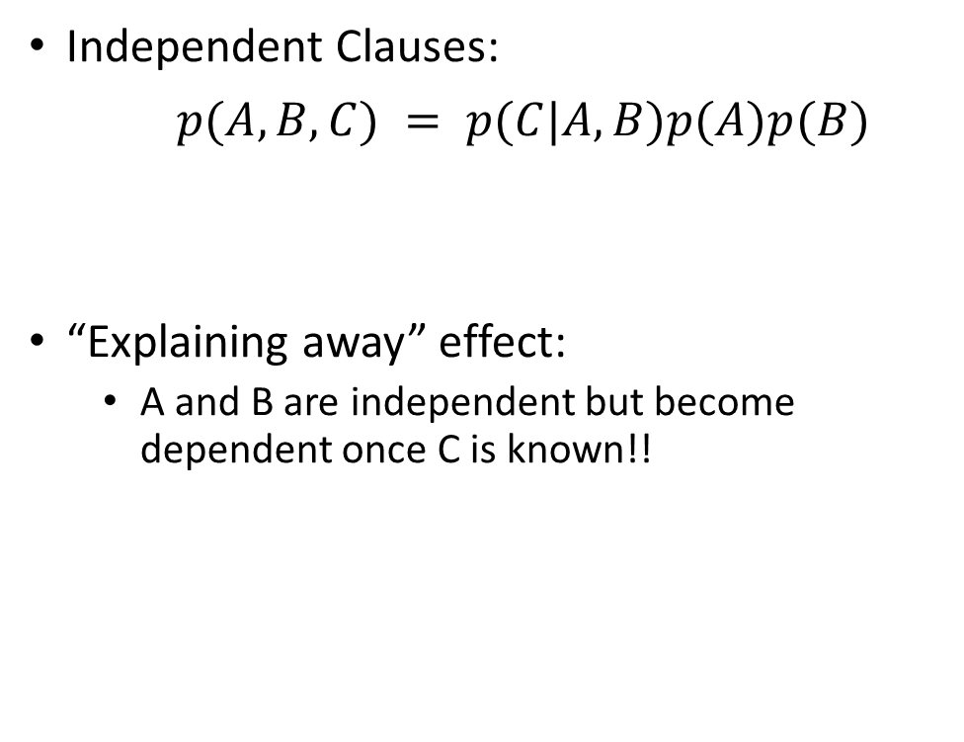
Examples of 3-way Bayesian Networks
Independent Clauses:
$p(A,B,C) = p(C|A,B)p(A)p(B)$
“Explaining away” effect:
A and B are independent but become dependent once C is known!!
A
B
C

Slide 11
Examples of 3-way Bayesian Networks
A
B
C
Markov dependence:
p(A,B,C) = p(C|B) p(B|A)p(A)

Slide 12
The Alarm Example
You have a new burglar alarm installed
It is reliable about detecting burglary, but responds to minor earthquakes
Two neighbors (John, Mary) promise to call you at work when they hear the alarm
John always calls when hears alarm, but confuses alarm with phone ringing (and calls then also)
Mary likes loud music and sometimes misses alarm!
Given evidence about who has and hasn’t called, estimate the probability of a burglary

Slide 13
The Alarm Example
Represent problem using 5 binary variables:
B = a burglary occurs at your house
E = an earthquake occurs at your house
A = the alarm goes off
J = John calls to report the alarm
M = Mary calls to report the alarm
What is P(B | M, J) ?
We can use the full joint distribution to answer this question
Requires 2⁵ = 32 probabilities
Can we use prior domain knowledge to come up with a Bayesian network that requires fewer probabilities?

Slide 14
Constructing a Bayesian Network: Step 1
Order the variables in terms of causality (may be a partial order)
e.g., {E, B} -> {A} -> {J, M}
Use these assumptions to create the graph structure of the Bayesian network

Slide 15
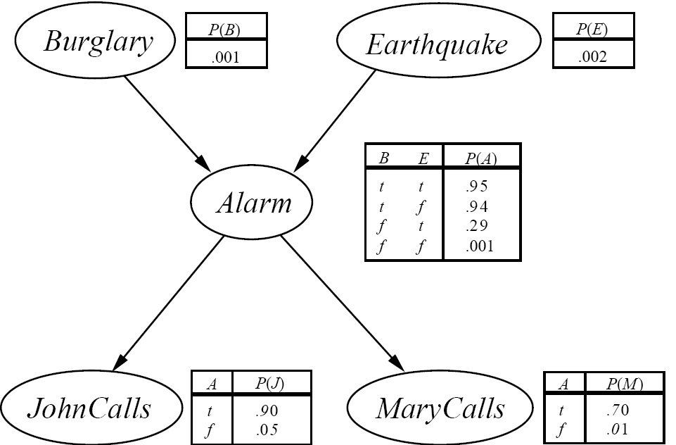
The Resulting Bayesian Network
network topology reflects causal knowledge

Slide 16

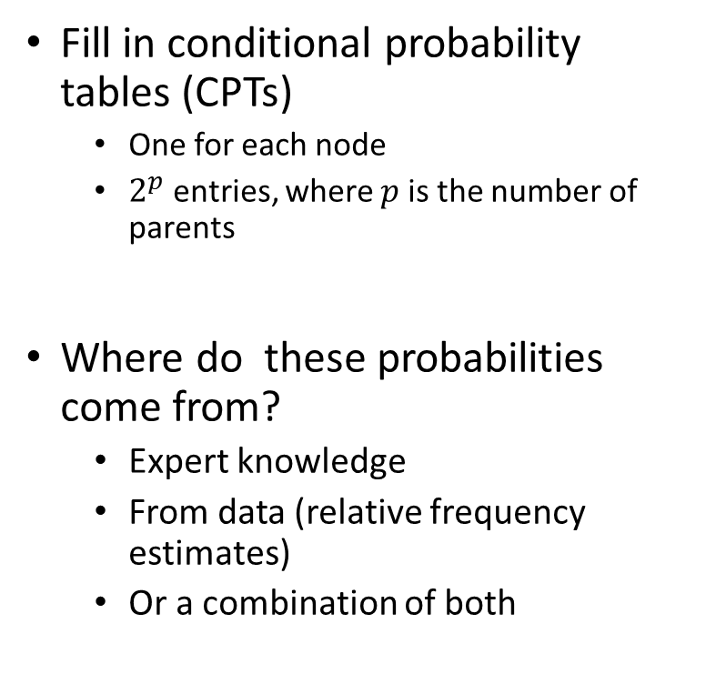
Constructing a Bayesian Network: Step 2
Fill in conditional probability tables (CPTs)
One for each node
$2^{p}$ entries, where $p$ is the number of parents
Where do these probabilities come from?
Expert knowledge
From data (relative frequency estimates)
Or a combination of both

Slide 17
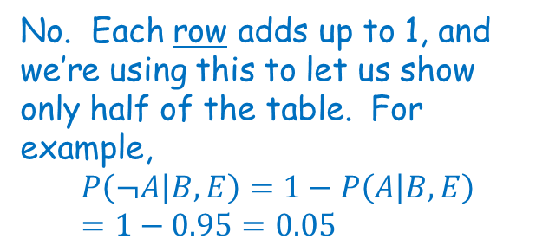
The Bayesian network
Shouldn’t these add up to 1?
No. Each row adds up to 1, and we’re using this to let us show only half of the table. For example,
$$P\left(¬A | B,E\right)=1−P\left(A | B,E\right)=1−0.95=0.05$$

Slide 18
The Bayesian network
What is P(j ∧ m ∧ a ∧ ¬b ∧ ¬e)?
P (j | a) P (m | a) P (a | ¬b, ¬e) P (¬b) P (¬e)

Slide 19
Tour through Probability
All probabilities are between 0 and 1
Necessarily true propositions have probability=1 and necessarily false propositions have probability=0

Slide 20
Conjunctions and Disjunctions
Venn Diagrams
P(A & B) = P(A) x P(B)
P(A v B) = P(A) + P(B)
(mutually exclusive)
P(A v B)
=P(A)+P(B) - P(A & B)
(not mutually exclusive)
A
B
A
B
A
B

Slide 21
Conditional probability & independence
Probability of B “given” A:
Independence:
P(B|A)=P(A&B)
P(A)
E.g. P(Hearts|Heart last time)
P(B|A)=P(B)
E.g. P(Heads|Even) = P(Heads)

Slide 22
Probability Distributions
Probability Distribution:
p(Weather=Sunny) = 0.5
p(Weather=Rain)= 0.2
p(Weather=Cloud)= 0.2
p(Weather=Snow)= 0.1
NB Distribution sums to 1.
0.5
0.2
0.1
S R C S

Slide 23
Joint Probability
Completely specifies all beliefs in a problem domain.
Joint prob Distribution is an n-dimensional table with a probability in each cell of that state occurring.
Written as P(X₁, X₂, X₃ …, X_{n})
When instantiated as P(x₁,x₂ …, x_{n})

Slide 24
Joint Distribution Example
Domain with 2 variables each of which can take on 2 states.
P(Toothache, Cavity)
Toothache ¬Toothache
Cavity 0.04 0.06
¬Cavity 0.01 0.89

Slide 25
Bayes’ Theorem
Simple:
P(Y|X) = P(X|Y)P(Y) P(X)
General:
P(Y|X,E) = P(X|Y,E)P(Y|E) P(X|E)

Slide 26
Number of Probabilities in Bayesian Networks (i.e. why Bayesian Networks are effective)
Consider n binary variables
Unconstrained joint distribution requires O(2^{n}) probabilities
If we have a Bayesian network, with a maximum of k parents for any node, then we need O(n 2^{k}) probabilities

Slide 27
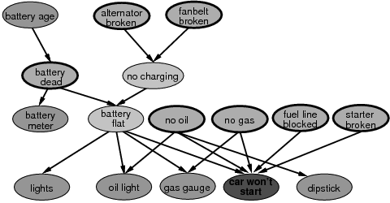
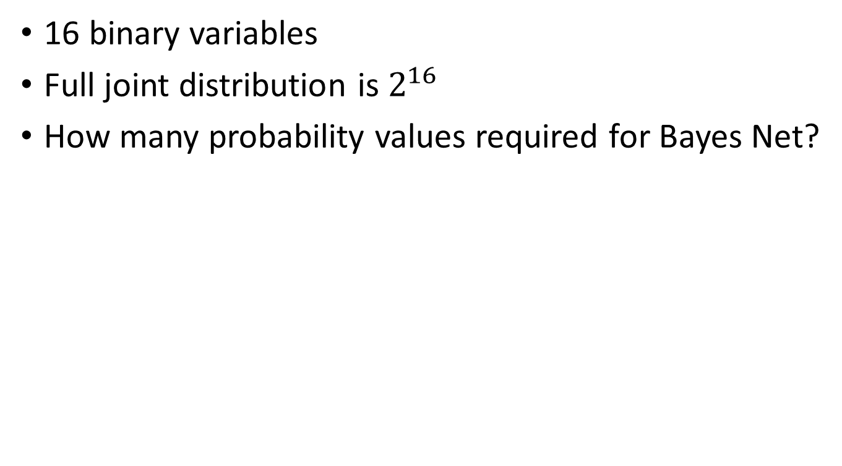
16 binary variables
Full joint distribution is $2^{16}$
How many probability values required for Bayes Net?

Slide 28
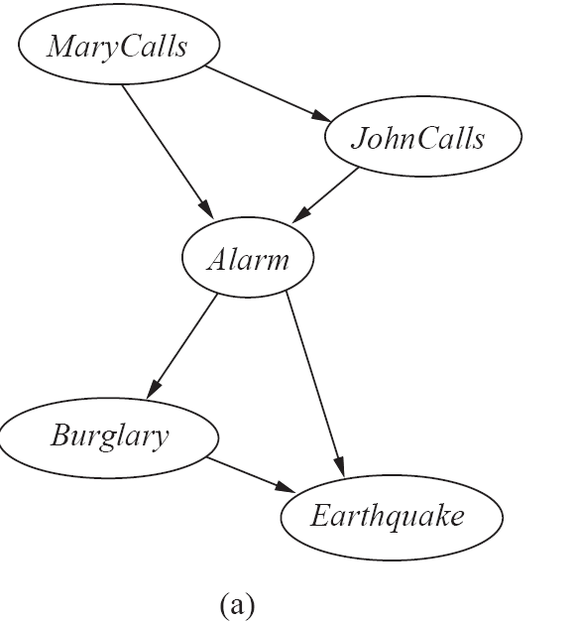
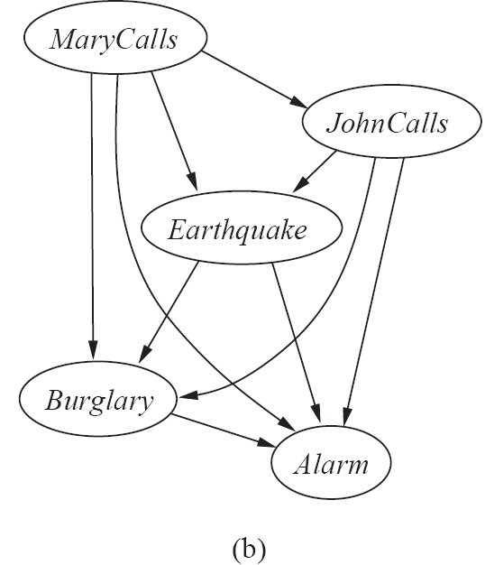
Bayesian Networks from a different Variable Ordering

Slide 29
Example for BN construction: Fire Diagnosis
You want to diagnose whether there is a fire in a building
You receive a noisy report about whether everyone is leaving the building
If everyone is leaving, this may have been caused by a fire alarm
If there is a fire alarm, it may have been caused by a fire or by tampering
If there is a fire, there may be smoke

Slide 30
Example for BN construction: Fire Diagnosis
First you choose the variables. In this case, all are Boolean:
Tampering is true when the alarm has been tampered with
Fire is true when there is a fire
Alarm is true when there is an alarm
Smoke is true when there is smoke
Leaving is true if there are lots of people leaving the building
Report is true if the sensor reports that lots of people are leaving the building
Let’s construct the Bayesian network for this
First, you choose a total ordering of the variables, let’s say: Fire; Tampering; Alarm; Smoke; Leaving; Report.

Slide 31
Example for BN construction: Fire Diagnosis

Slide 32
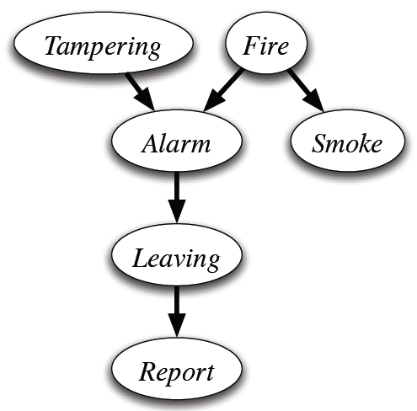
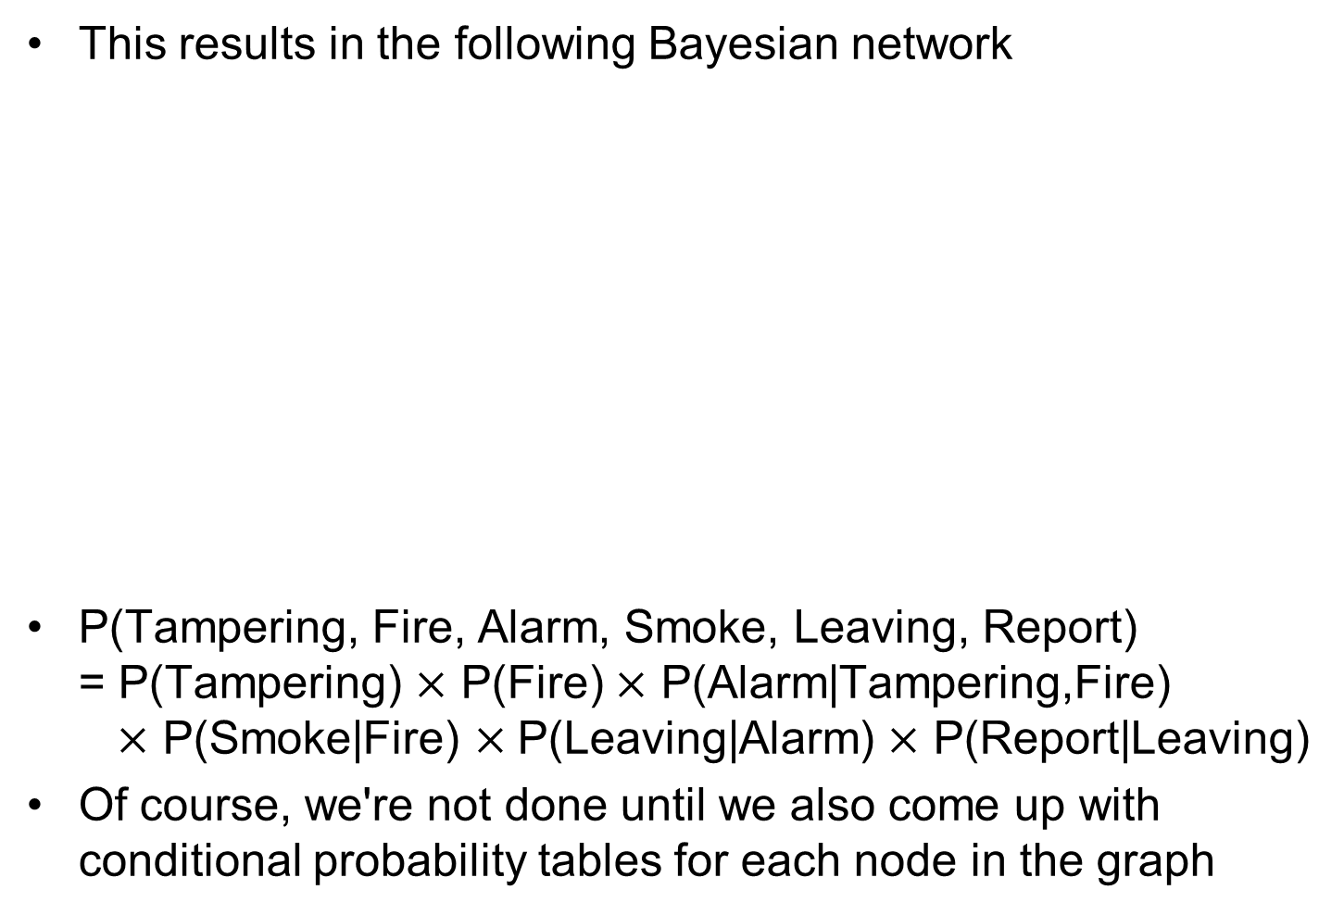
Example for BN construction: Fire Diagnosis

Slide 33
Example for BN construction: Fire Diagnosis
Using the total ordering of variables:
Let’s say Fire; Tampering; Alarm; Smoke; Leaving; Report.
Now choose the parents for each variable by evaluating conditional independencies
Fire is the first variable in the ordering. It does not have parents.
Tampering independent of fire (learning that one is true would not change your beliefs about the probability of the other)
Alarm depends on both Fire and Tampering: it could be caused by either or both
Smoke is caused by Fire, and so is independent of Tampering and Alarm given whether there is a Fire
Leaving is caused by Alarm, and thus is independent of the other variables given Alarm
Report is caused by Leaving, and thus is independent of the other variables given Leaving

Slide 34
Example for BN construction: Fire Diagnosis
How many probabilities do we need to specify for this Bayesian network?
1+1+4+2+2+2 = 12

Slide 35

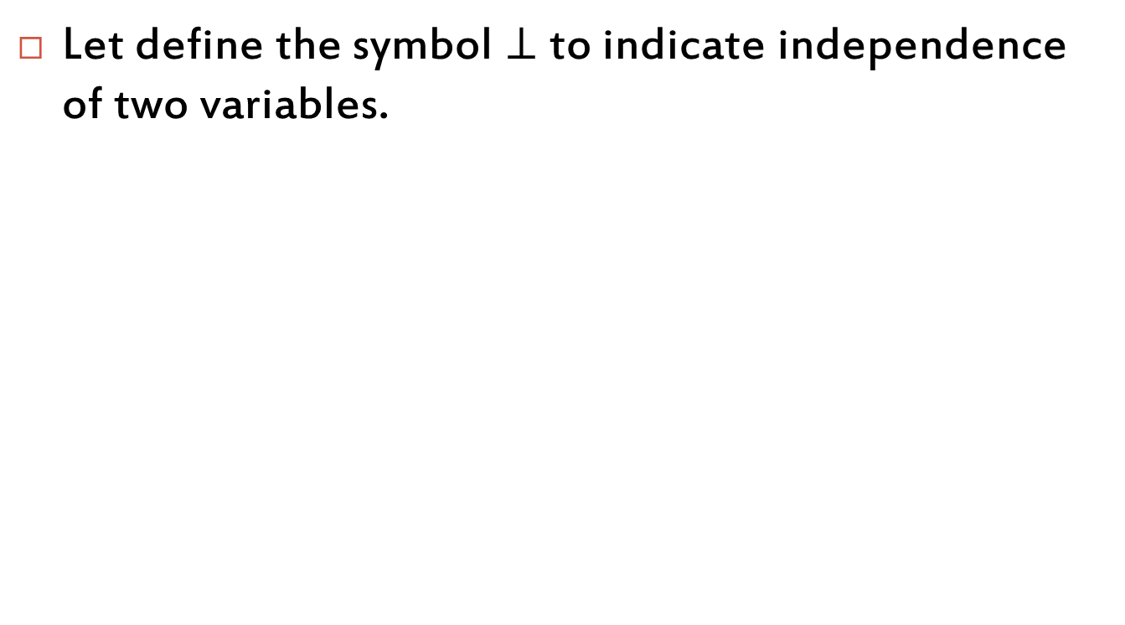
Independence
Let define the symbol $⊥$ to indicate independence of two variables.
A
B
C
$$A⊥B$$
$$A⊥C$$
$$B⊥C$$

Slide 36
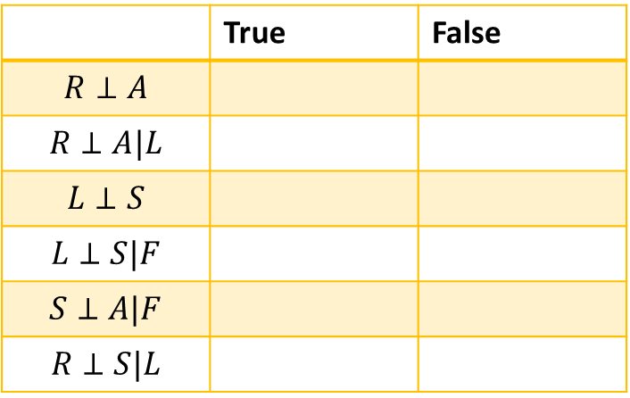
Independence
 | True | False
$$R⊥A$$
$$R⊥A|L$$
$$L⊥S$$
$$L⊥S|F$$
$$S⊥A|F$$
$$R⊥S|L$$
General rule of thumb:
A known variable makes everything below that variable independent from everything above that variable.

Slide 37
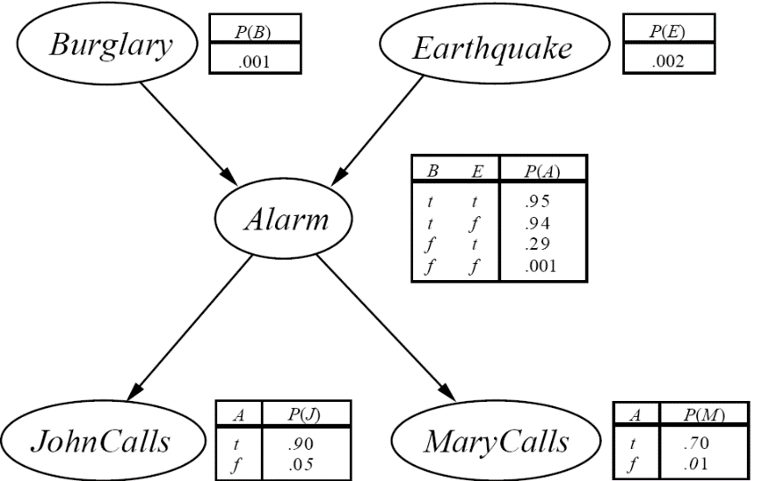
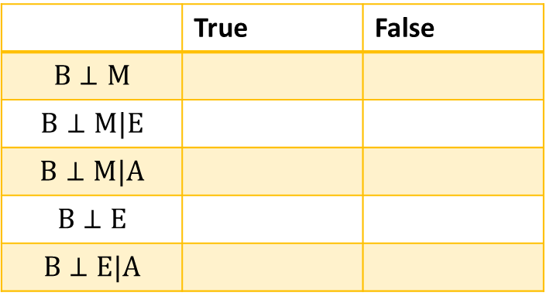
Another (tricky) Example
 | True | False
$$B⊥M$$
$$B⊥M|E$$
$$B⊥M|A$$
$$B⊥E$$
$$B⊥E|A$$

Slide 38
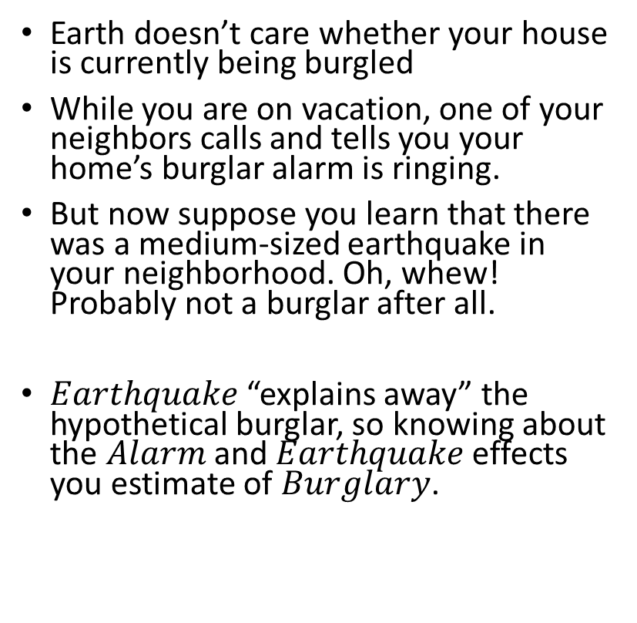
Explaining Away
Earth doesn’t care whether your house is currently being burgled
While you are on vacation, one of your neighbors calls and tells you your home’s burglar alarm is ringing.
But now suppose you learn that there was a medium-sized earthquake in your neighborhood. Oh, whew! Probably not a burglar after all.
$Earthquake$“explains away” the hypothetical burglar, so knowing about the $Alarm$and $Earthquake$effects you estimate of $Burglary$.

Slide 39
Belief Networks
Burglary
P(B)
0.001
Earthquake
P(E)
0.002
Burg. Earth. P(A)
t t .95
t f .94
f t .29
f f .001
Alarm
JohnCalls
A P(J)
t .90
f .05
MaryCalls
A P(M)
t .7
f .01

Slide 40
Full Joint Distribution

Slide 41
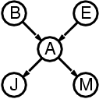
Compactness
A CPT for Boolean X_{i} with k Boolean parents has 2^{k} rows for the combinations of parent values
Each row requires one number p for X_{i} = true (the number for X_{i} = false is just 1-p)
If each variable has no more than k parents, the complete network requires O(n · 2^{k}) numbers
I.e., grows linearly with n, vs. O(2^{n}) for the full joint distribution
For burglary net, 1 + 1 + 4 + 2 + 2 = 10 numbers (vs. 2⁵-1 = 31)

Slide 42
Inference in Bayesian Networks
How can one infer the (probabilities of) values of one or more network variables, given observed values of others?
Bayes net contains all information needed for this inference
If only one variable with unknown value, easy to infer it
In general case, problem is NP hard

Slide 43
Inference
Diagnostic Inferences (effects to causes)
Causal Inferences (causes to effects)
Intercausal Inferences - or ‘Explaining Away’ (between causes of common effect)
Mixed Inferences (combination of two or more of the above)

Slide 44
Inference contd.
Q
E
Q
E
E
Q
E
Q
E
Diagnostic Causal Intercausal Mixed

Slide 45
Inference contd.
Burglary
Earthquake
Alarm
Mary Calls
John Calls

Slide 46
Inference in Singly Connected Networks
E.g. P(X|E):
Involves computing two values:
Causal Support (evidence variables above X connected through it’s parents)
Evidential Support (evidence variables below X connected through it’s children
Algorithm can perform in Linear Time.

Slide 47
Inference Algorithm
E
Spreads out from Q to
evidence nodes, root
nodes and leaf nodes.
Each recursive call
excludes the node from
which it was called.
Causal Support
Q
E
E
Evidential Support

Slide 48
Inference in Multiply Connected Networks
Exact Inference is known to be NP-Hard
Approaches include:
Clustering
Conditioning
Stochastic Simulation
Stochastic Simulation is most often used, particularly on large networks.

Slide 49
Clustering
Cloudy
Cloudy
Sprinkler
Rain
Sprinkler & Rain
P(S&R)
C P(R)
T .08 .02
F .40 .10
C TT TF FT FF
T .08 .02 .72 .18
F .40 .10 .40 .10
C P(S)
T .08 .02
F .40 .10
Wet Grass
Wet Grass

Slide 50
Conditioning
₊
₊
-
-
Cloudy
Cloudy
Cloudy
Cloudy
Sprinkler
Rain
Sprinkler
Rain
Wet Grass
Wet Grass

Slide 51
Stochastic Simulation - Example
P(A=1) = 0.2
A
A P(B=1)
0 0.2
1 0.8
A p(C=1)
0 0.05
1 0.2
B
C
D
E

Slide 52
Stochastic Simulation Run repeated simulations to estimate the probability distribution
Let Wx = the states of all other variables except x.
Let the Markov Blanket of a node be all of its parents, children and parents of children.
Distribution of each node, x, conditioned upon Wx can be computed locally from their own probability with their children’s :
P(a|Wa) = α . P(a) . P(b|a) . P(c|a)
P(b|Wb) = α . P(b|a) . P(d|b,c)
P(c|Wc) = α . P(c|a) . P(d|b,c) . P(e|c)
Therefore, only the Markov blanket of a node is required to compute the distribution

Slide 53
The Algorithm
Set all observed nodes to their values
Set all other nodes to random values
STEP 1
Select a node randomly from the network
According to the states of the node’s markov blanket, compute P(x=state, Wx) for all states
STEP 2
Use a random number generator that is biased according to the distribution computed in step 1 to select the next value of the node
Repeat

Slide 54
Example
In the burglary network, we migth observe the event in which JohnCalls=true and MarryCalls=true
We could ask for the probability that the burglary has occured
P(Burglary|JohnCalls=ture,MarryCalls=true)

Slide 55
Remember - Joint distribution

Slide 56
Normalization

Slide 57
Normalization
X is the query variable
E evidence variable
Y remaining unobservable variable
Summation over all possible y (all possible values of the unobservable varables Y)

Slide 58
P(Burglary|JohnCalls=ture,MarryCalls=true)
The hidden variables of the query are Earthquake and Alarm
For Burglary=true in the Bayesain network

Slide 59
To compute we had to add four terms, each computed by multipling five numbers
In the worst case, where we have to sum out almost all variables, the complexity of the network with n Boolean variables is O(n2^{n})

Slide 60
P(b) is constant and can be moved out, P(e) term can be moved outside summation a
JohnCalls=true and MarryCalls=true, the probability that the burglary has occured is aboud 28%

Slide 61
Constructing Bayesian Networks
A Bayesian network is a correct representation of the domain only if each node is conditionally independent of its predecessors in the ordering, given its parents
P(MaryCalls|JohnCalls,Alarm,Eathquake,Bulgary)=P(MaryCalls|Alarm)

Slide 62
Constructing Bayesian networks
1. Choose an ordering of variables X₁, … ,X_{n}
2. For i = 1 to n
add X_{i} to the network
select parents from X₁, … ,X_{i-1} such that
P (X_{i} | Parents(X_{i})) = P (X_{i} | X₁, ... X_{i-1})
This choice of parents guarantees:
P (X₁, … ,X_{n}) = π^{n}_{i =1} P (X_{i} | X₁, … , X_{i-1}) (chain rule)
= π^{n}_{i =1}P (X_{i} | Parents(X_{i})) (by construction)

Slide 63
The compactness of Bayesian networks is an example of locally structured systems
Each subcomponent interacts directly with only bounded number of other components
Constructing Bayesian networks is difficult
Each variable should be directly influenced by only a few others
The network topology reflects thes direct influences

